Slide 1
HIV/AIDS Data Analysis and Prediction Project
HIV
Xuanbo Zhou
Student ID: A20563441

Slide 2
CONTENTS
Problem Definition
Data Analysis
Model Construction and Training and Model Evaluation
Analysis and Insights

Slide 3
Problem Definition
/01

Slide 4
Problem Definition
Project Background: HIV/AIDS remains one of the major global public health challenges. Understanding its transmission trends, mortality rates, and influencing factors is crucial for public health policy-making worldwide.
Data Source: The dataset used in this project is obtained from Our World in Data.
Project Objectives:
Perform data cleaning and visualization to uncover annual trends and country-level distribution of HIV/AIDS.
Conduct clustering analysis of country characteristics to support policy categorization.
Build supervised learning models to predict annual death counts and compare model performance.
Real-world Significance: The results of this analysis can support global health interventions, vaccine allocation, and funding decisions.

Slide 5
Data Analysis
/02

Slide 6
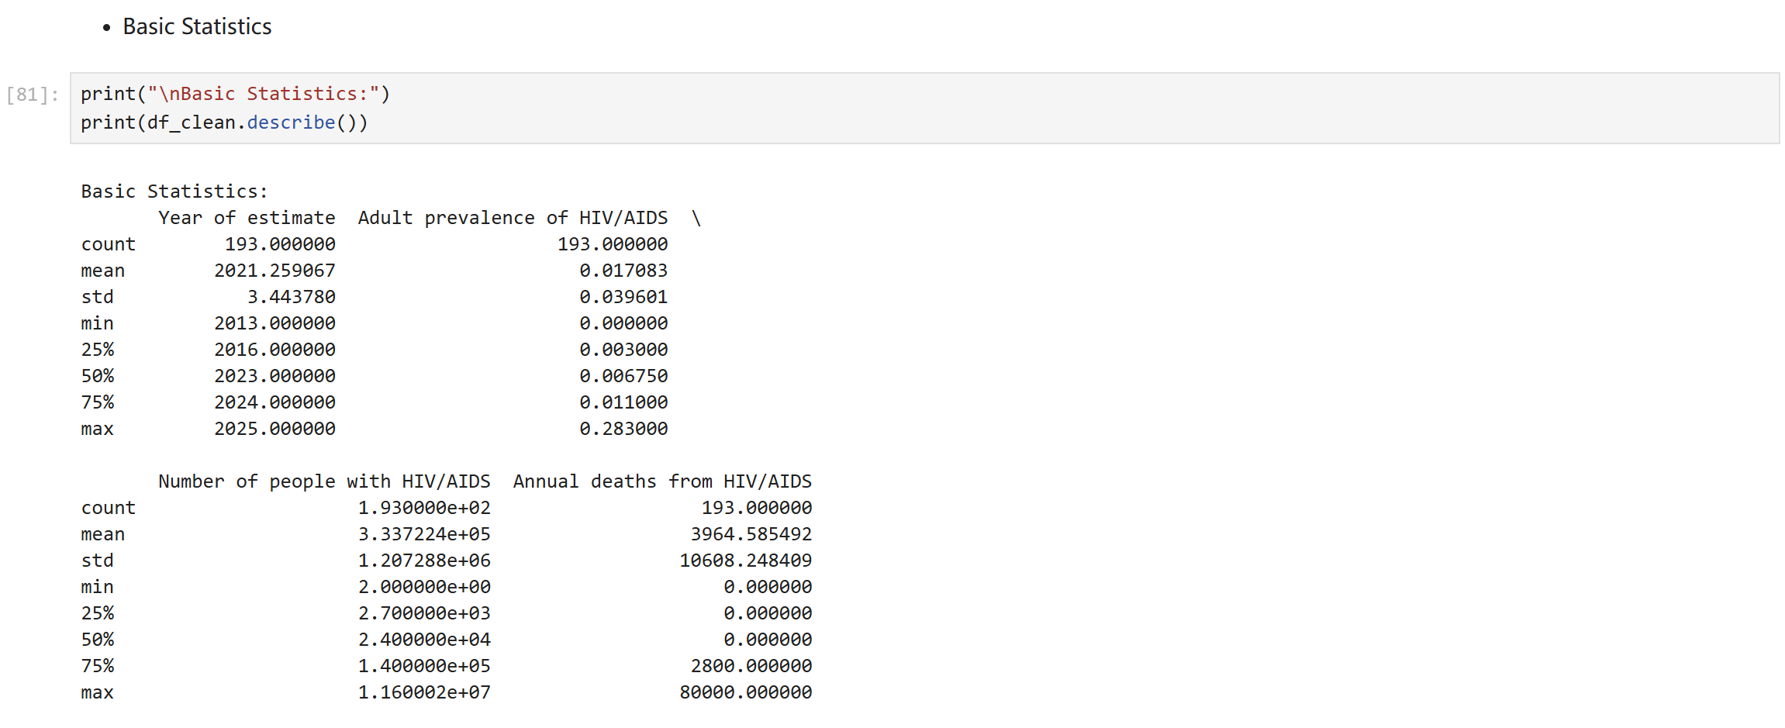
Data Analysis

Slide 7
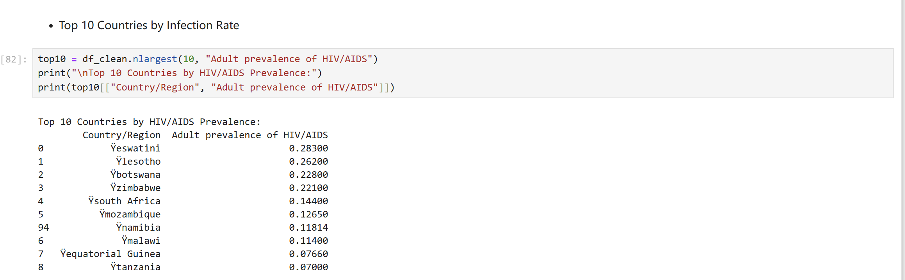
Data Analysis

Slide 8
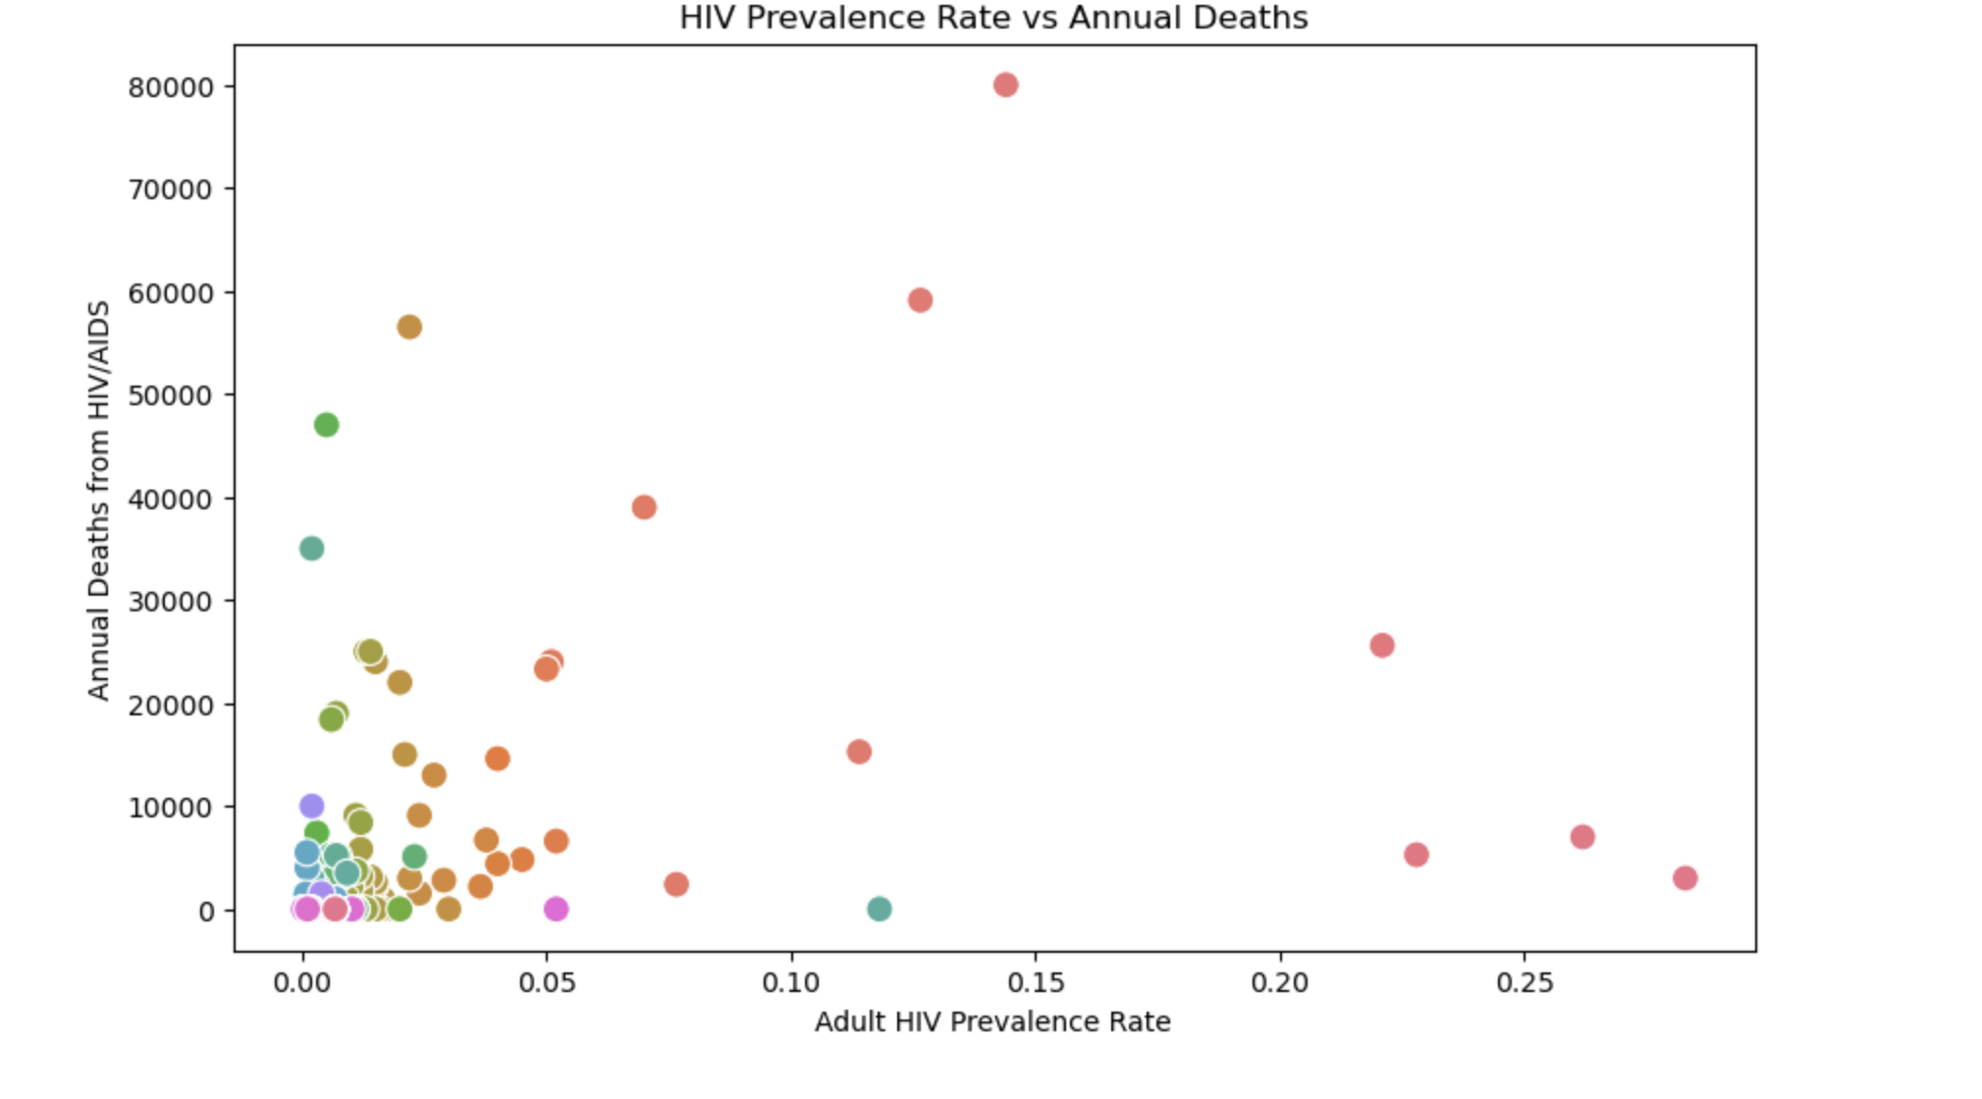
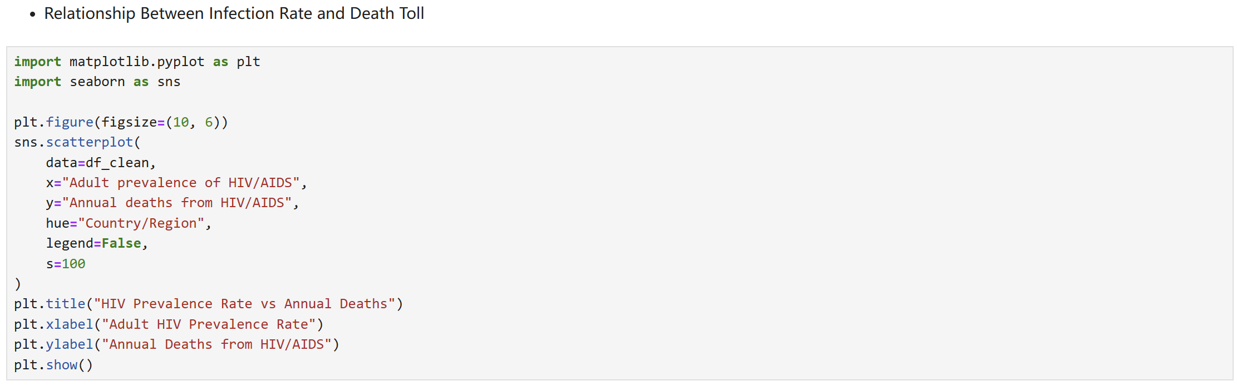
Data Analysis

Slide 9
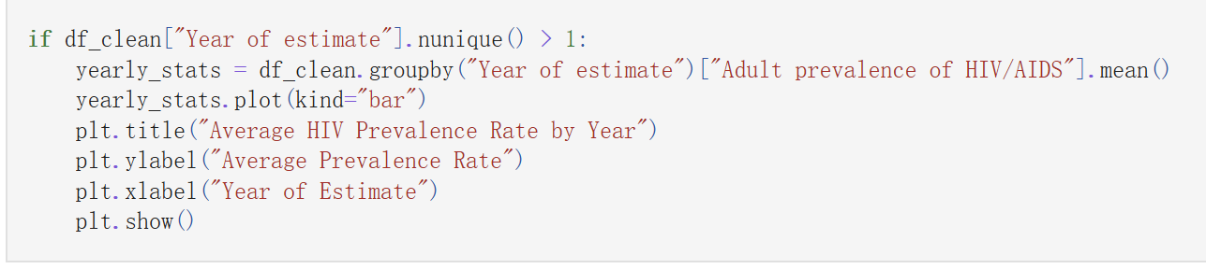
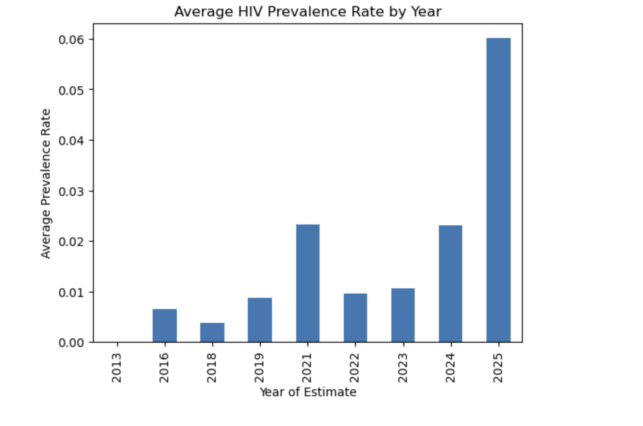
Data Analysis

Slide 10
Model Construction and Training and Model Evaluation
/03

Slide 11
Model Construction and Training and Model Evaluation
Model Selection and Rationale
In this project, we chose the Linear Regression model to predict the annual HIV/AIDS death count for each country. The reasons for selecting this model are as follows:
Linear correlation between features and target: For example, there is a significant linear trend between "adult HIV prevalence" and "number of people with HIV/AIDS" with "death count".
Model interpretability: The model allows for a clear understanding of how each feature impacts the death count.
Computational efficiency: It is suitable for medium-sized structured data and trains quickly.
Base model construction: This allows for comparison with more complex models (such as tree models and neural networks) in later stages.
Training Process, Including Hyperparameter Settings
Feature Selection:
Independent variables (X):
Adult prevalence of HIV/AIDS
Number of people with HIV/AIDS
Dependent variable (y):
Annual deaths from HIV/AIDS
Data Split:
Using train_test_split, the data is split into 80% for training and 20% for testing.
Set random_state=42 to ensure reproducibility of results.
Model Training:
The model is trained using sklearn.linear_model.LinearRegression().
Linear regression does not require explicit hyperparameter tuning, as it automatically fits the best parameters to minimize Mean Squared Error (MSE).

Slide 12
Model Construction and Training and Model Evaluation
Model Evaluation
Using Appropriate Performance Metrics
R² Score (Coefficient of Determination):
Measures the proportion of variance in the dependent variable that is explained by the model.
Ranges from [0, 1], with values closer to 1 indicating better model fit.
RMSE (Root Mean Squared Error):
Measures the deviation between predicted and actual values.
The unit is consistent with the original data, and smaller values are better. )

Slide 13
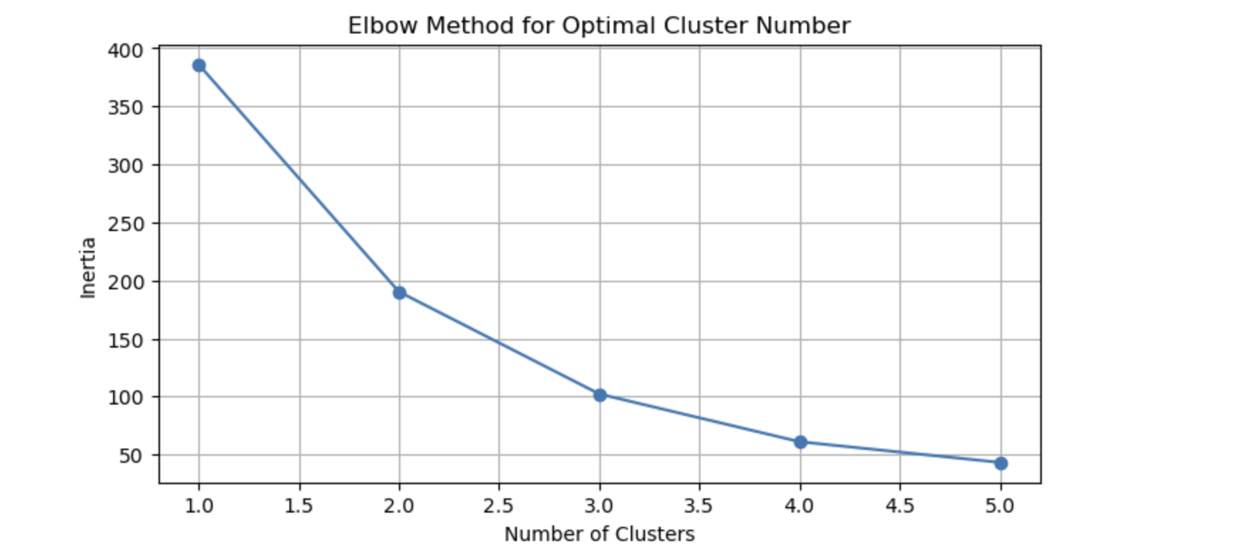
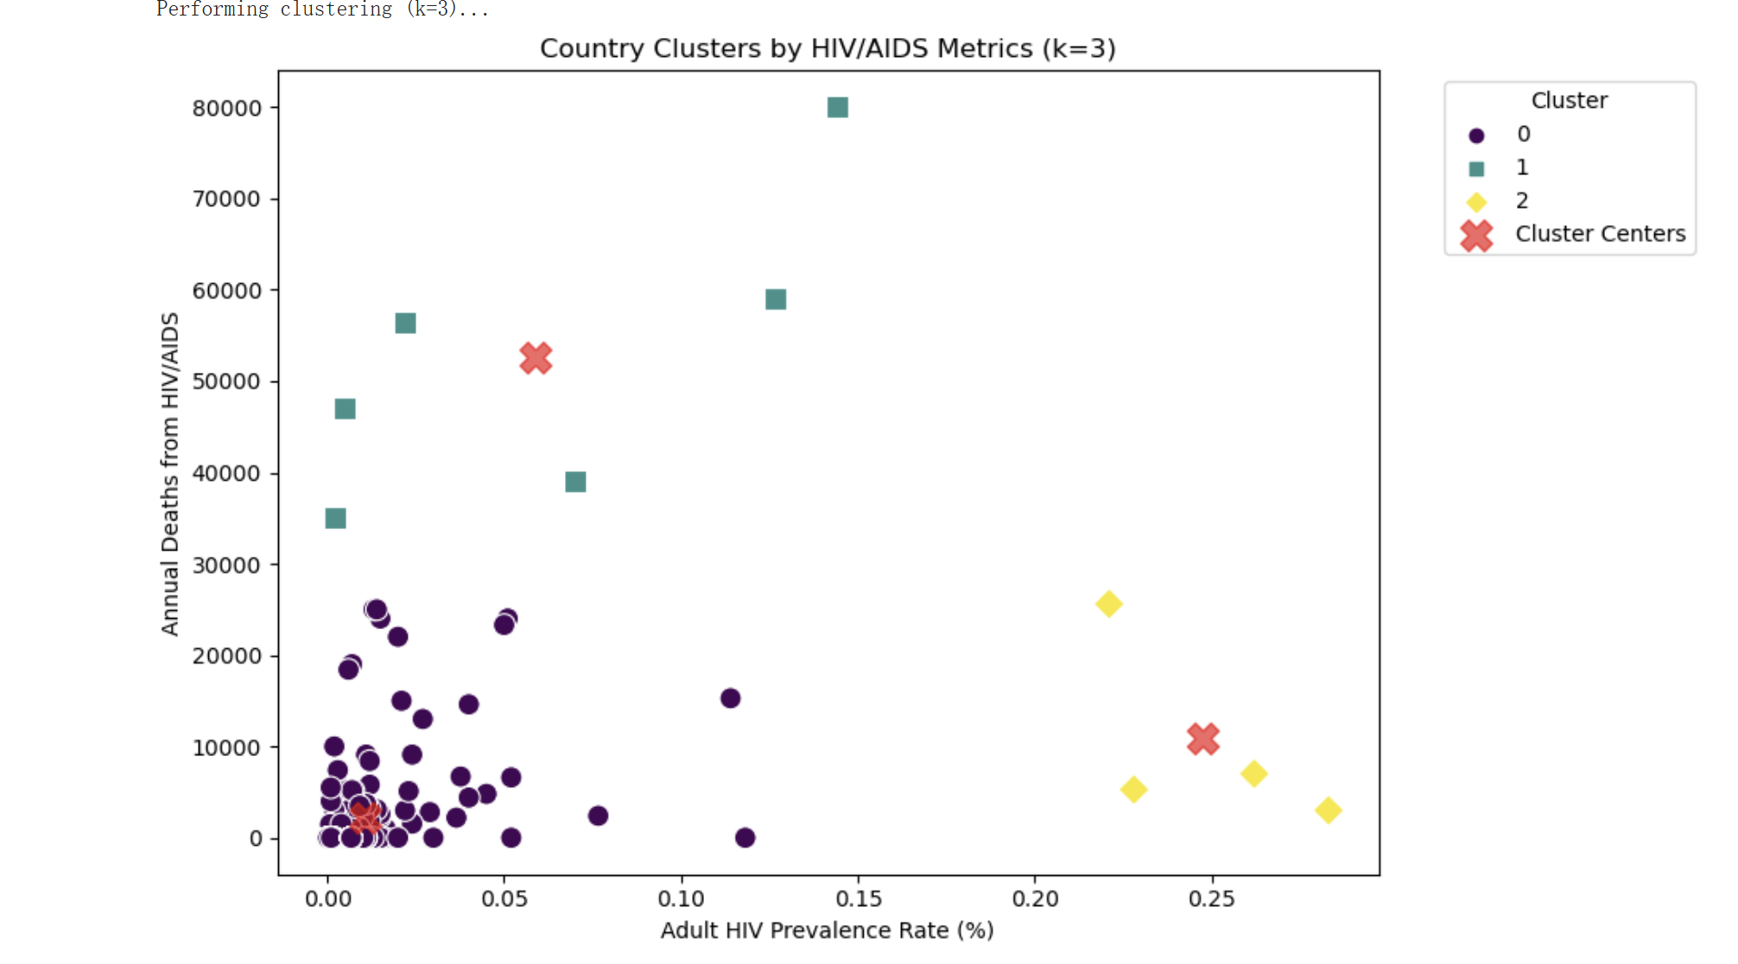
Model Construction and Training and Model Evaluation

Slide 14
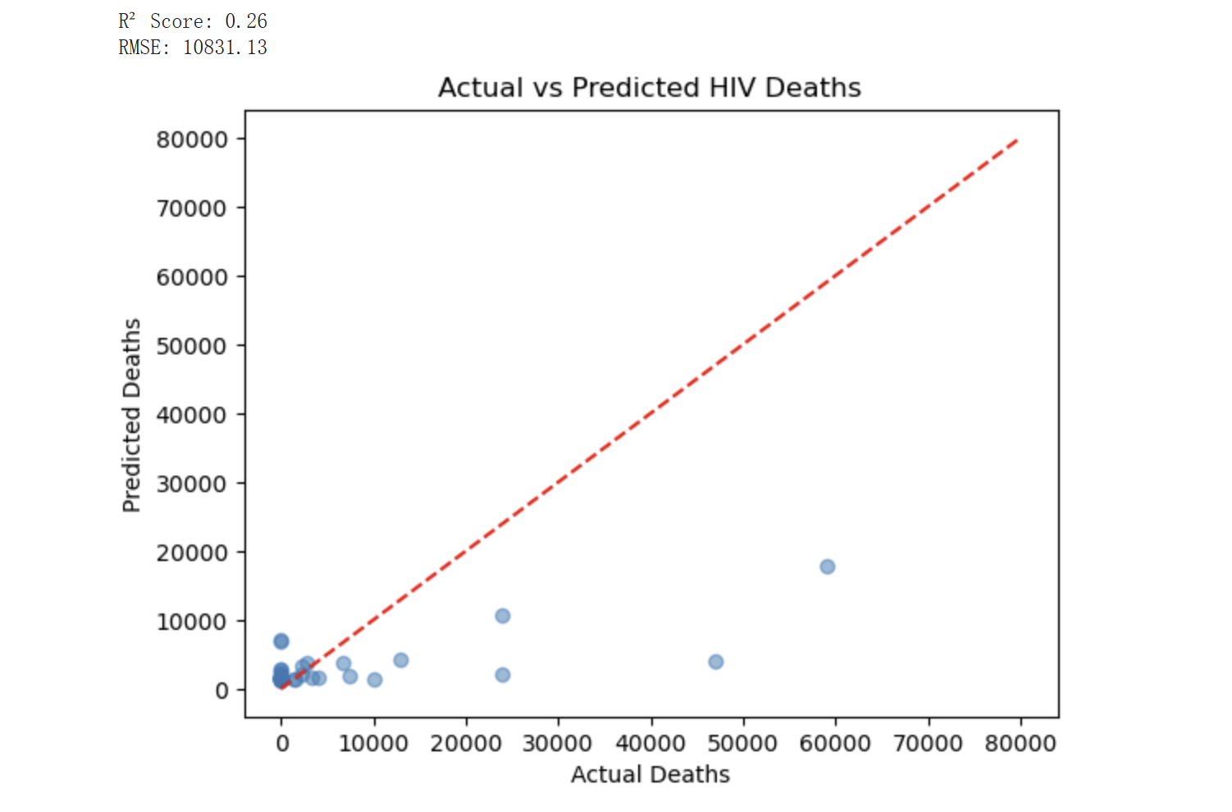
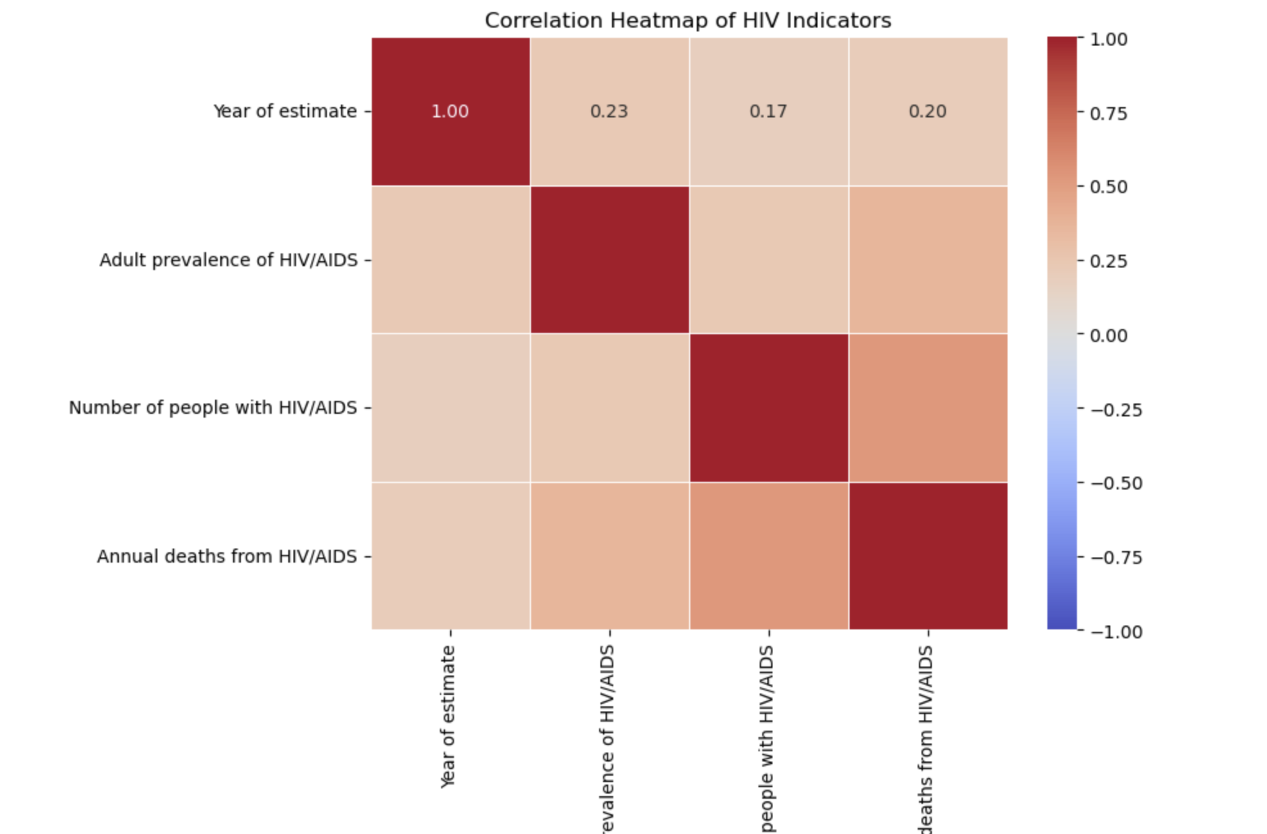
Model Construction and Training and Model Evaluation

Slide 15
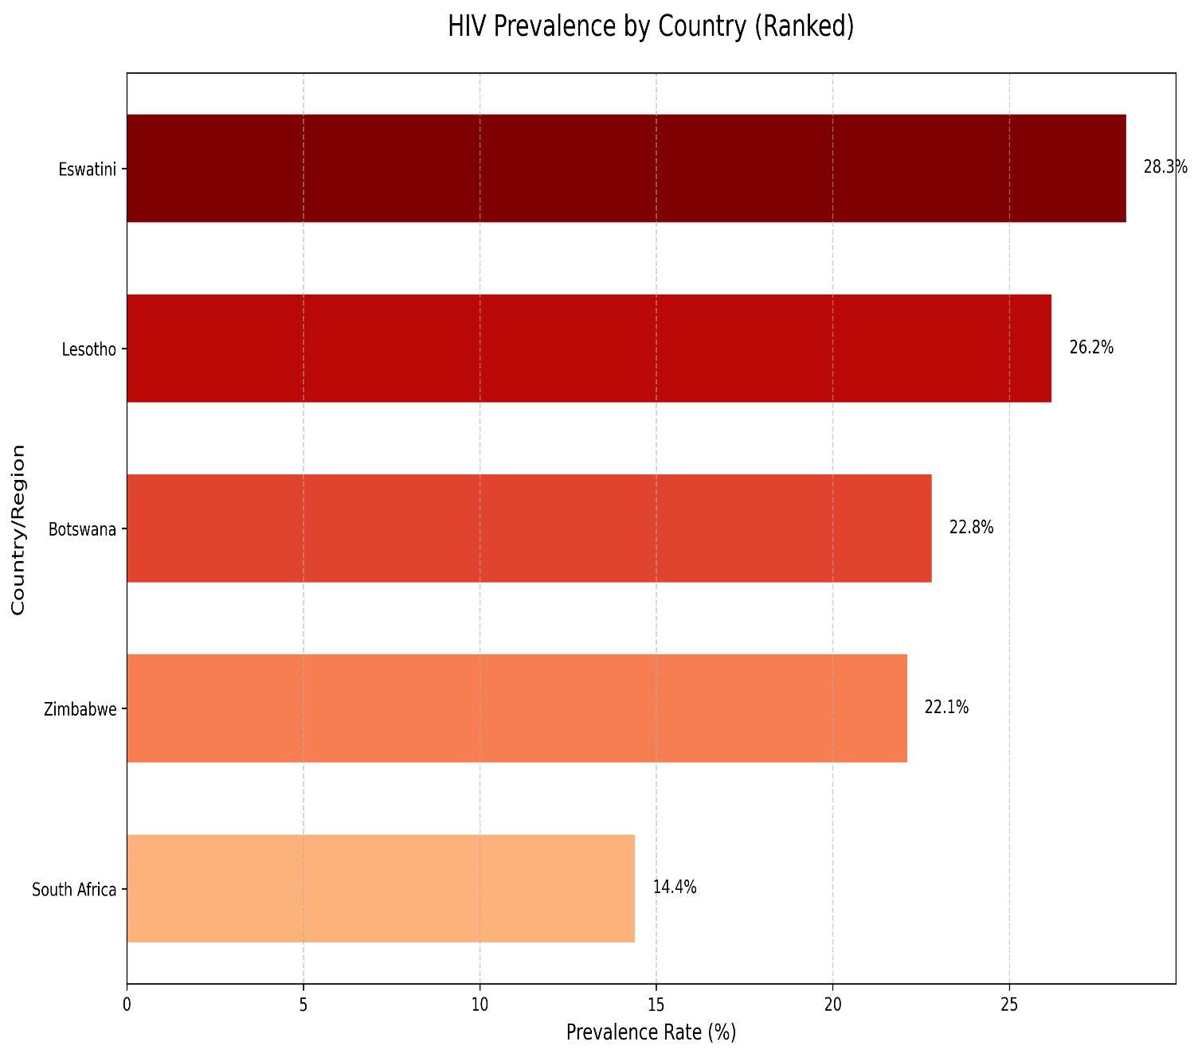
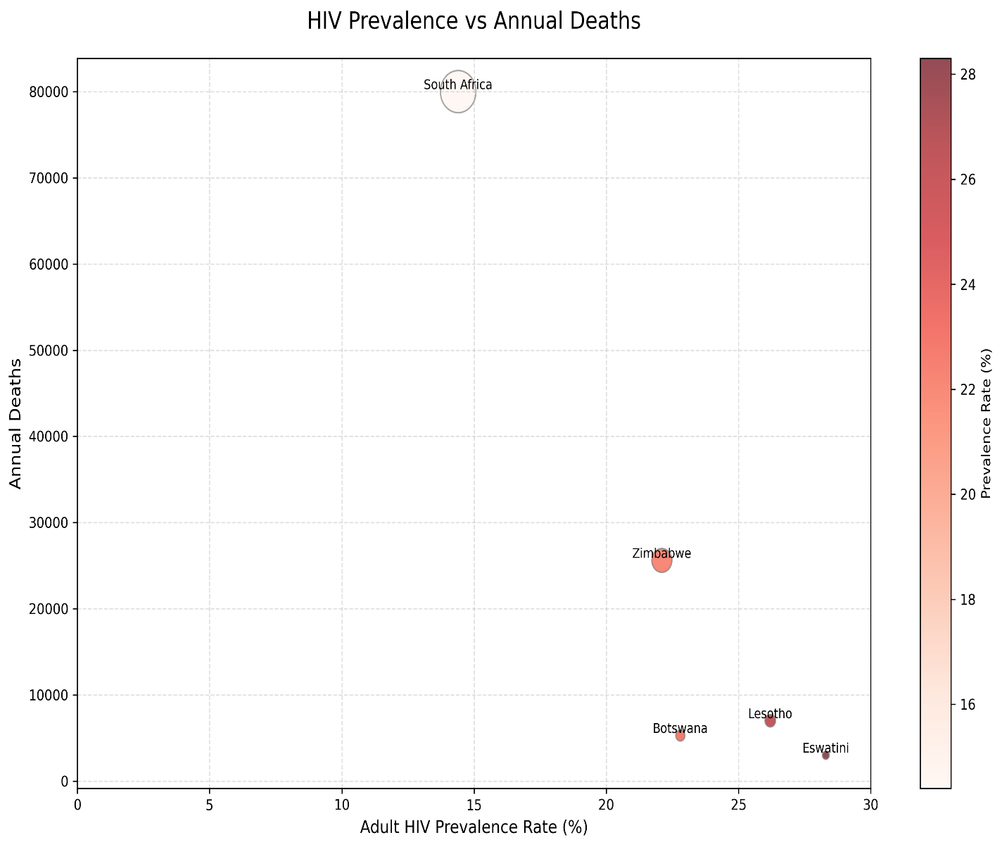
Model Construction and Training and Model Evaluation

Slide 16
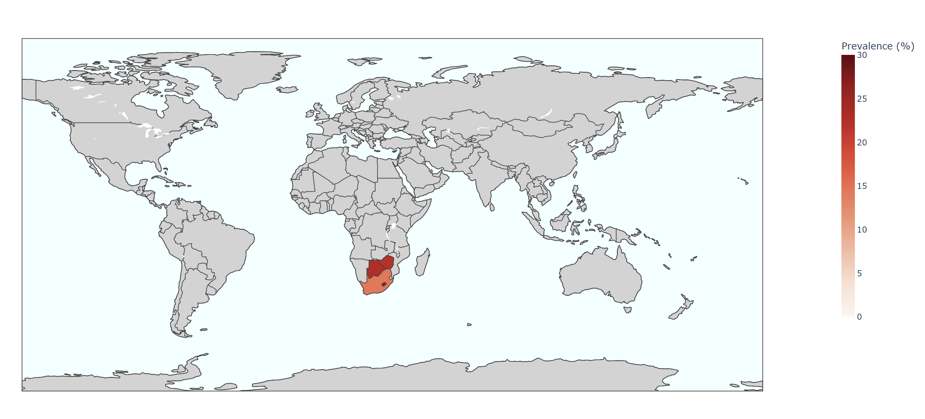
Model Construction and Training and Model Evaluation

Slide 17
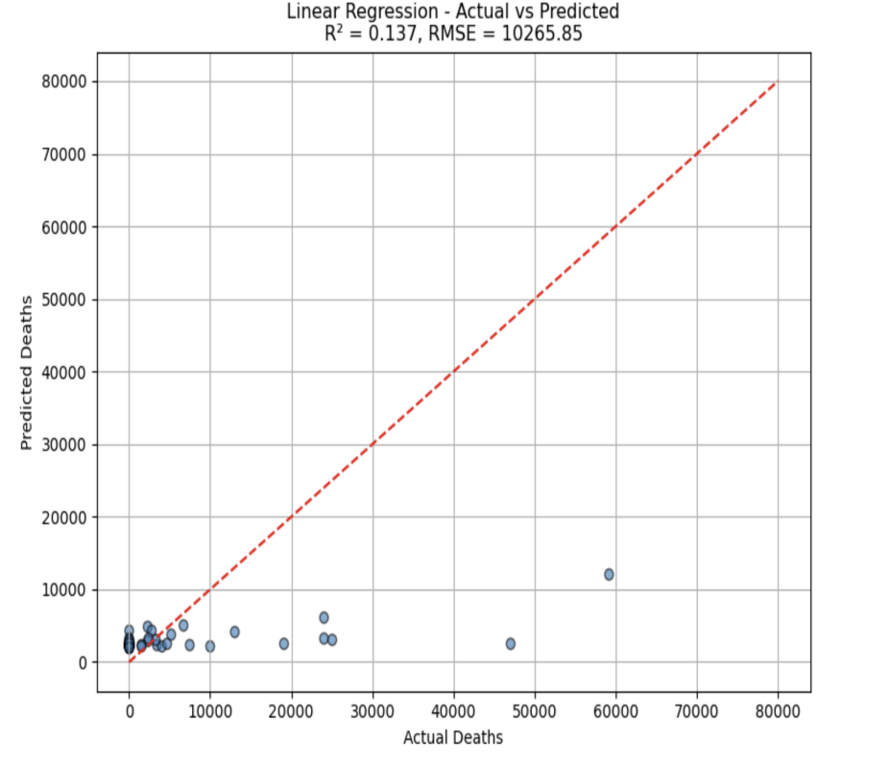
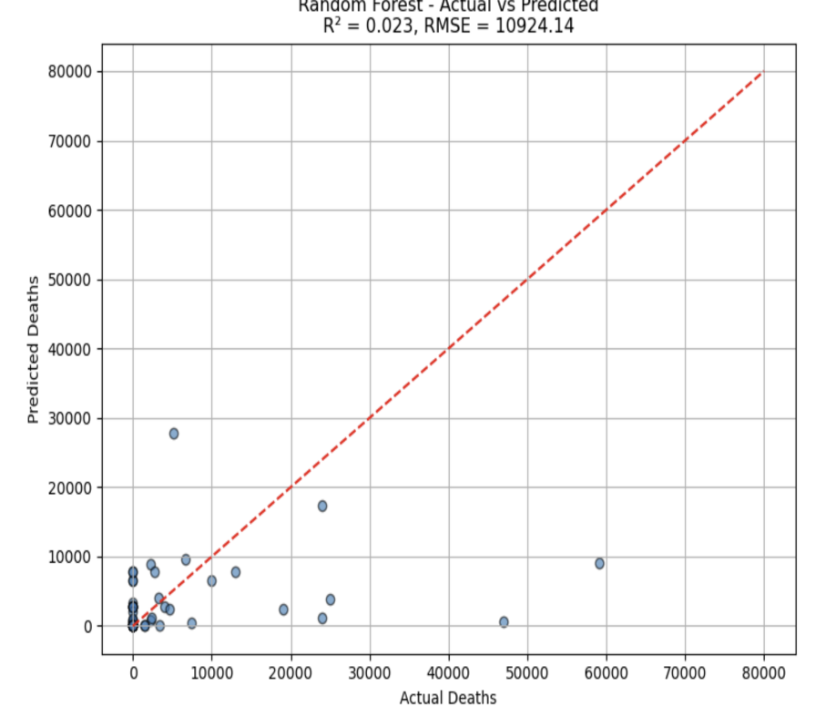
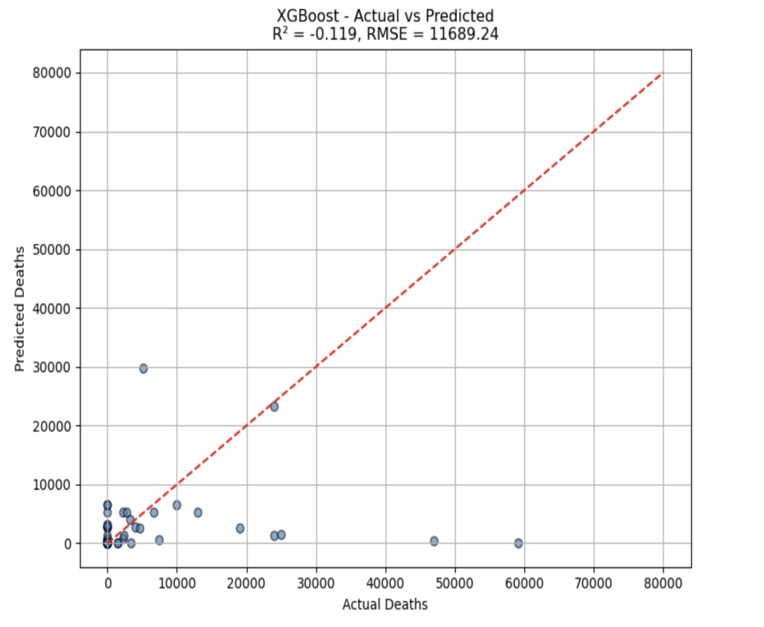
Model Construction and Training and Model Evaluation

Slide 18
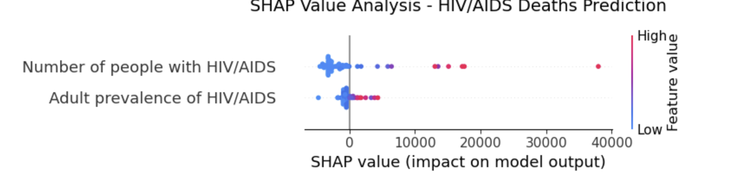
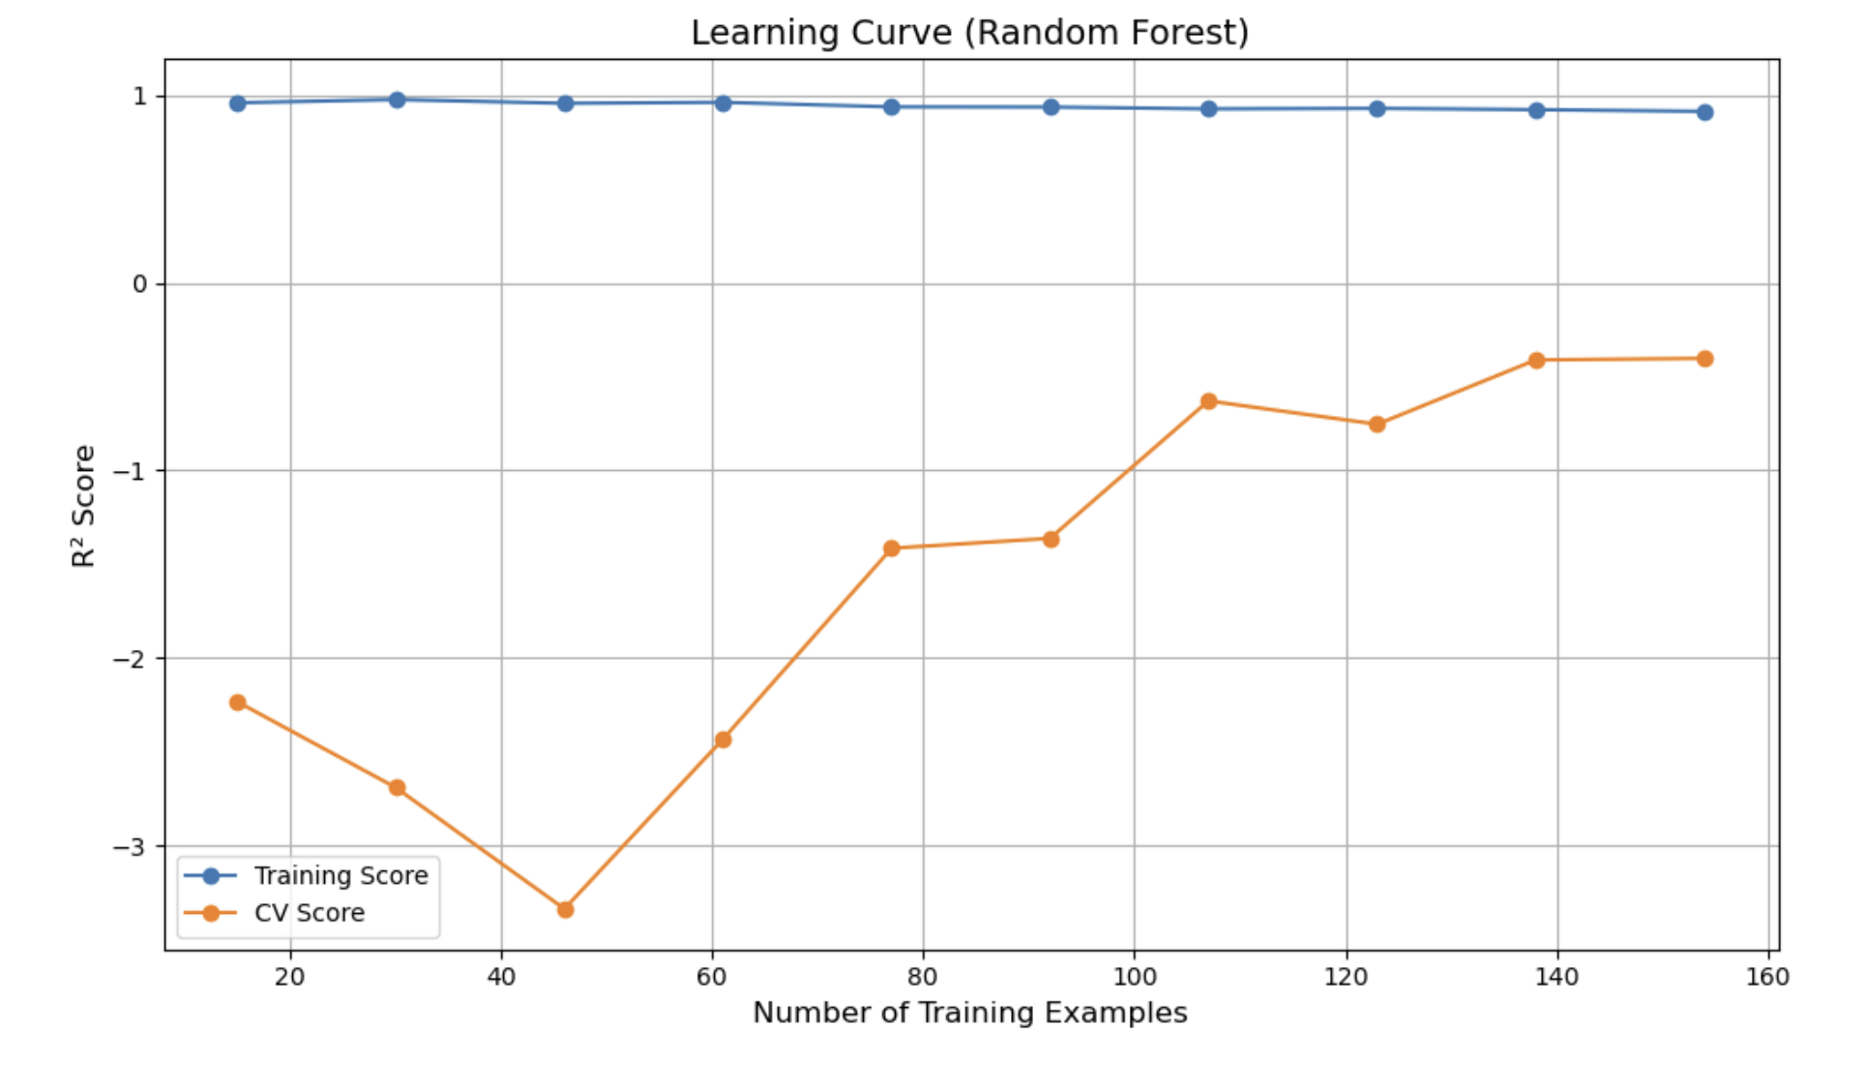
Model Construction and Training and Model Evaluation

Slide 19
Analysis and Insights
/04

Slide 20
Analysis and Insights
Adult HIV Infection Rate and Number of Infections Significantly Impact Death Rates The model indicates a strong positive correlation between these two variables and the number of deaths, making them major influencing factors.
Some Countries Have Significant Deviations from Predicted Death Rates Certain countries exhibit considerable differences in healthcare systems and prevention policies, warranting a focused investigation into the causes of these outliers.
Clustering Analysis Reveals High-Risk Country Groups The clustering results show that Southern African countries (such as Eswatini and Botswana) have both high infection and death rates, identifying them as high-risk regions.
Global HIV Infection Rates Show an Overall Decline Although there is a decline, some countries still maintain high levels, necessitating continued policy interventions.
Model Explanation is Good but There is Room for Improvement Future work could consider introducing more complex models (e.g., XGBoost, Neural Networks) to enhance prediction accuracy.

Slide 21
Thanks. And Your Slogan Here.

